Slide 1

IETF Standardization Strategy Cisco Approach
Pradeep Kathail
Chief Software Architect
pkathail@cisco.com
November 8, 2017
Notes:
I’m here today to connect with you about the future of the Internet. The opportunities that new and more valuable connections will make possible. And, how we can help you solve the challenges ahead and help you succeed.

Slide 2
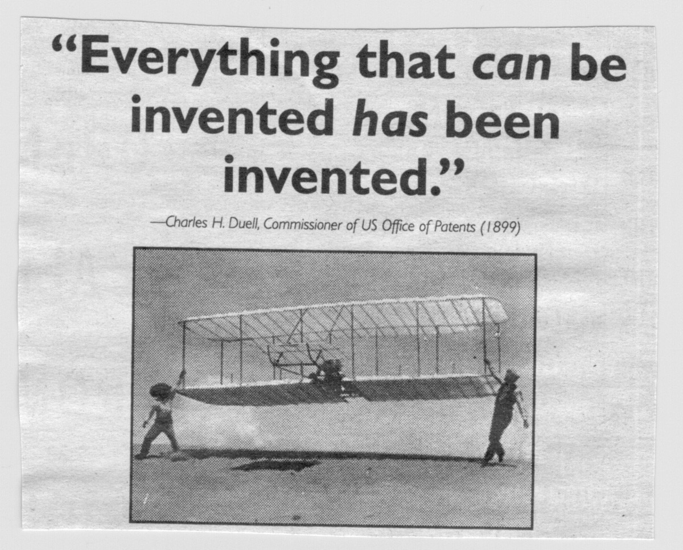

Slide 3

The Internet is evolving.
FAST.
Notes:
Clearly, the Internet is evolving. Fast.
We’re connecting more of our world every day. New connections. More valuable connections. The pace of change is accelerating.
Everything is coming online.

Slide 4

Only….
39
%
of the world is connected
80
%
Business processes powered by technology
13
billion
Connected things

Slide 5




Healthcare
Today?
Smart Home
Customer Experience

Slide 6



Smart Carts
Tomorrow
Self-Refill Bottles
Harvest Alert

Slide 7
India Leapfrogs in Technology
FAST.

Slide 8
Why Standardize?
Interoperability avoids Market Fragmentation

Slide 9
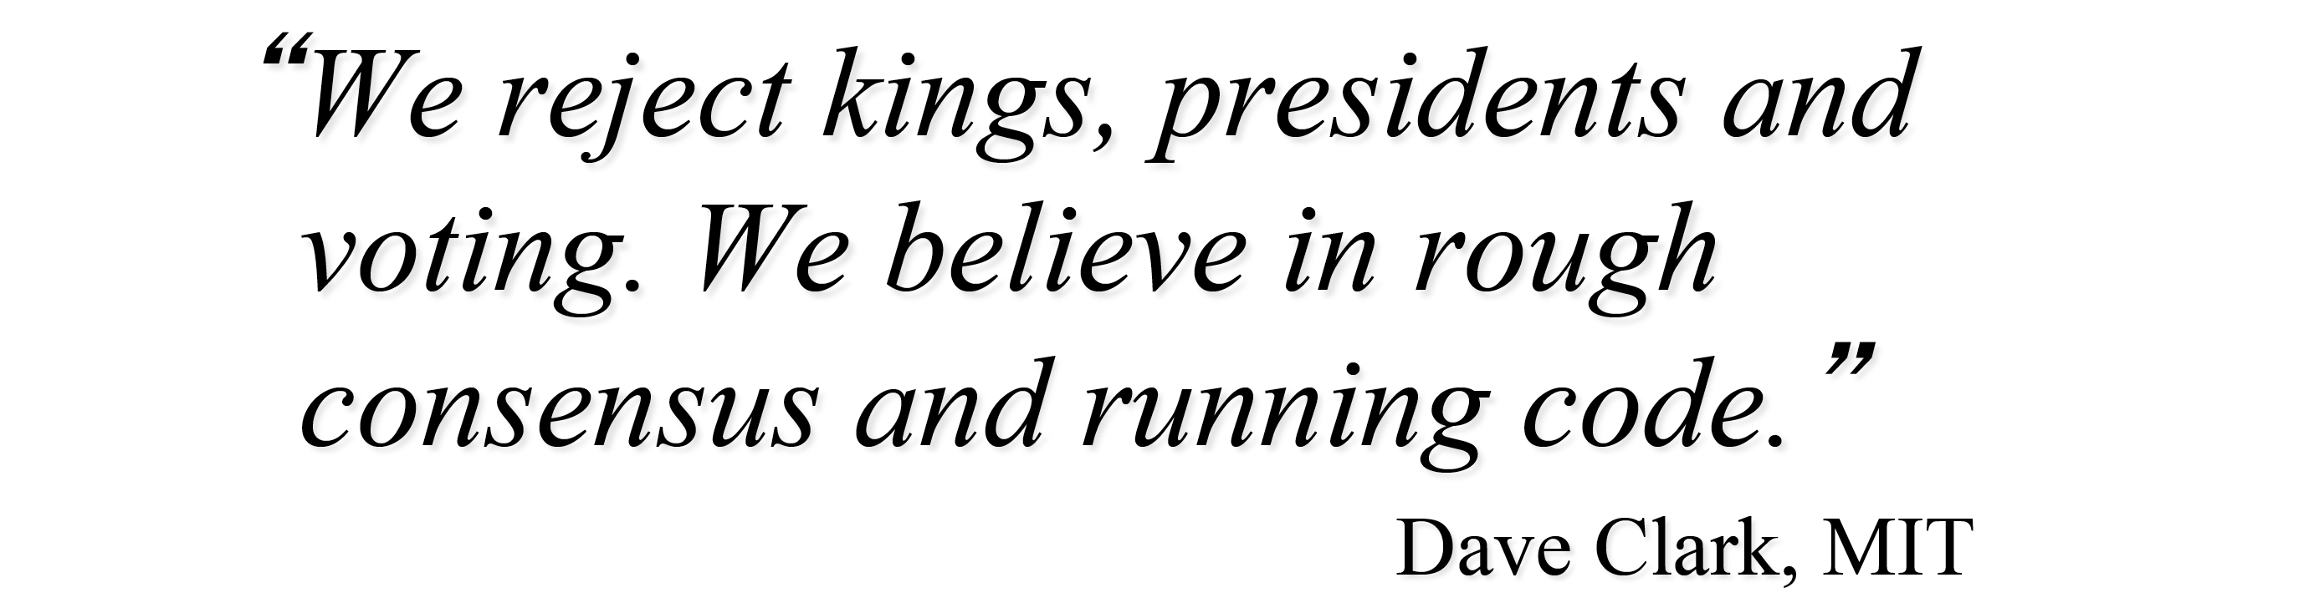
IETF Motto

Slide 10
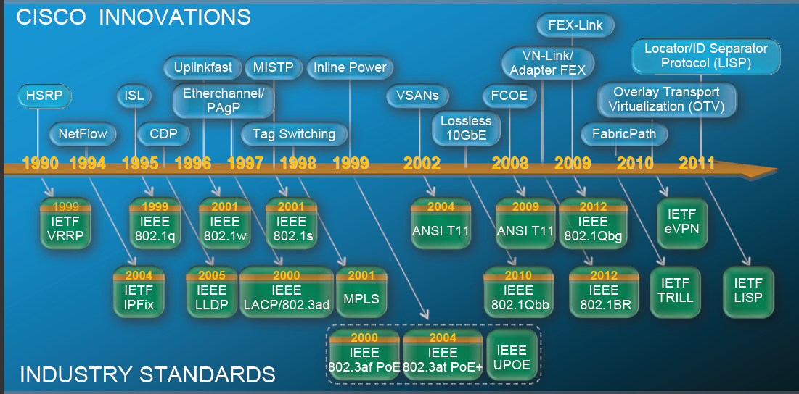
From Running Code to Industry Standards….
Notes:
As a matter of fact, we’ve done the math. It adds up to $19 trillion over the next 10 years. This is a combination of increased revenue and lower costs. This is new value generated and value migrating among industries and companies. (Note to presenter: $14.4 trillion private/$4.6 trillion public)
It’s a new era. Connections matter more than ever, and we measure results in only one way: meaningful outcomes.

Slide 11
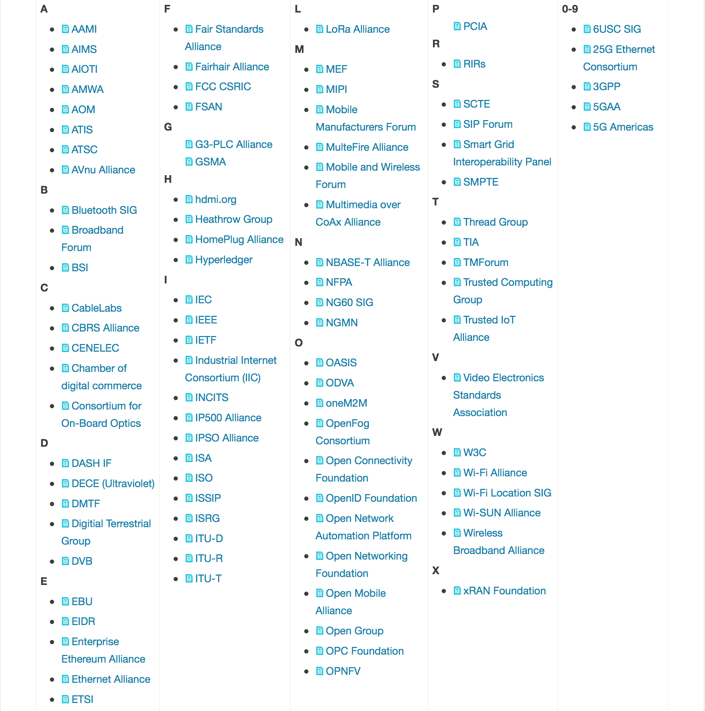
Many Vertical Specific SDOs / Industry Consortiums

Slide 12
And Don’t Forget..
Open Source

Slide 13
Where to Start?
Identify & Validate a problem that needs to be solved
Subscribe to the relevant (WG) mailing list
Follow the topics of interest
Identify key contributors in the interested area & WG
Work with them to solve the identified problem and publish a draft

Slide 14
The Internet just restarted
Great Time to Get Involved

